Slide 1
E R MODEL

Slide 2
Draw an entity relationship diagram for the given scenario
Suppose that you are designing a schema to record information about reality shows on TV. Your database needs to record the following information:
_ For each reality show, its name, genre, basic_info and participants name. Any reality show has at least two or more participants.
_ For each producer, the company name, company country. A show is produced by exactly one producer. And one producer produces exactly one show.
_ For each television, its name, start year, head office. A television may broadcasts multiple shows. Each show is broadcasted by exactly one television.
_ For each user, his/her username, password, and age. A user may rate multiple shows, and a show may be rated by multiple users. Each rating has a score of 0 to 10.
Draw an entity relationship diagram for this database.

Slide 3
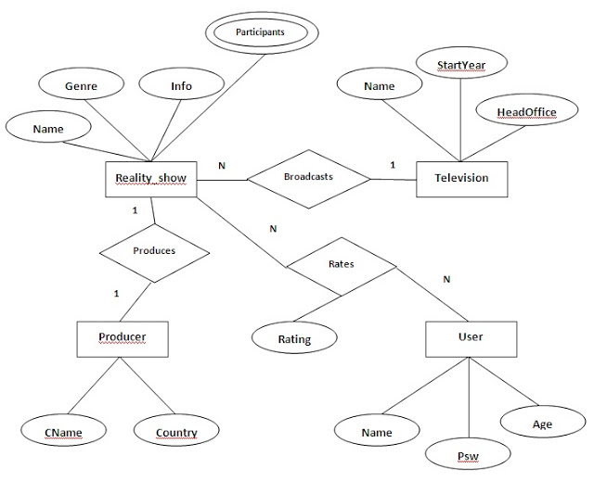

Slide 4
Consider a university database for the scheduling of classrooms for -final exams. This database could be modeled as the single entity set exam, with attributes course-name, sectionnumber, room-number, and time. Alternatively, one or more additional entity sets could bedefined, along with relationship sets to replace some of the attributes of the exam entity set, as
course with attributes name, department, and c-number
section with attributes s-number and enrollment, and dependent as a weak entity set on course
room with attributes r-number, capacity, and building
Show an E-R diagram illustrating the use of all three additional entity sets listed.

Slide 5
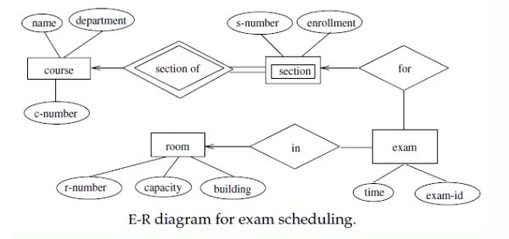

Slide 6
ER MODEL QUESTIONS
Construct an E-R diagram for a car-insurance company whose customers own one or more cars each. Each car has associated with it zero to any number of recorded accidents.

Slide 7
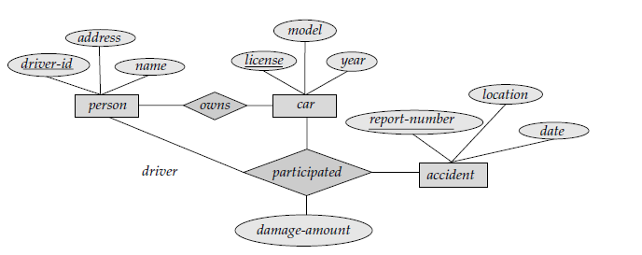

Slide 8
E R MODEL 3
Construct an E-R diagram for a hospital with a set of patients and a set of medical doctors. Associate with each patient a log of the various tests and examinations conducted.

Slide 9
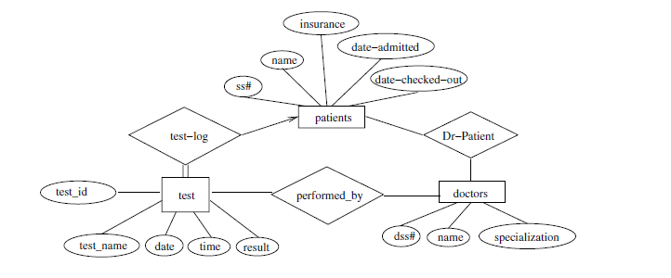

Slide 10
E R Model Question
A car rental company maintains a database for all vehicles in its current fleet. For all vehicles it includes the vehicle id number, License number, manufacturer model, date of purchase and color.
A special data are included for certain types of vehicles.
Trucks: cargo capacity
Sports car: horsepower, renter age requirement.
Van: number of passengers
Off road vehicles: ground clearance, drive train
Apply an ER model for car rental company database

